Slide 1


Introduction to Operating Systems CS 1550
Spring 2023
Sherif Khattab
ksm73@pitt.edu
(Some slides are from Silberschatz, Galvin and Gagne ©2013)

Slide 2
Announcements
Upcoming deadlines
Homework 9 due this Friday
Project 3 is due Friday 4/7 at 11:59 pm
Lab 4 is due on Tuesday 4/11 at 11:59 pm

Slide 3
Previous Lecture
How to simulate page replacement algorithms
Clock, LRU, OPT

Slide 4
This Lecture …
Problem of Too Large Page Tables
multi-level page tables + TLB
inverted page tables
Miscellaneous Memory Management Issues

Slide 5
Page Table Size
How big can a page table be?
64-bit machine
4 KB page size
How many pages?
How many PTEs?
How big is a PTE?
How big is the page table of one process?

Slide 6
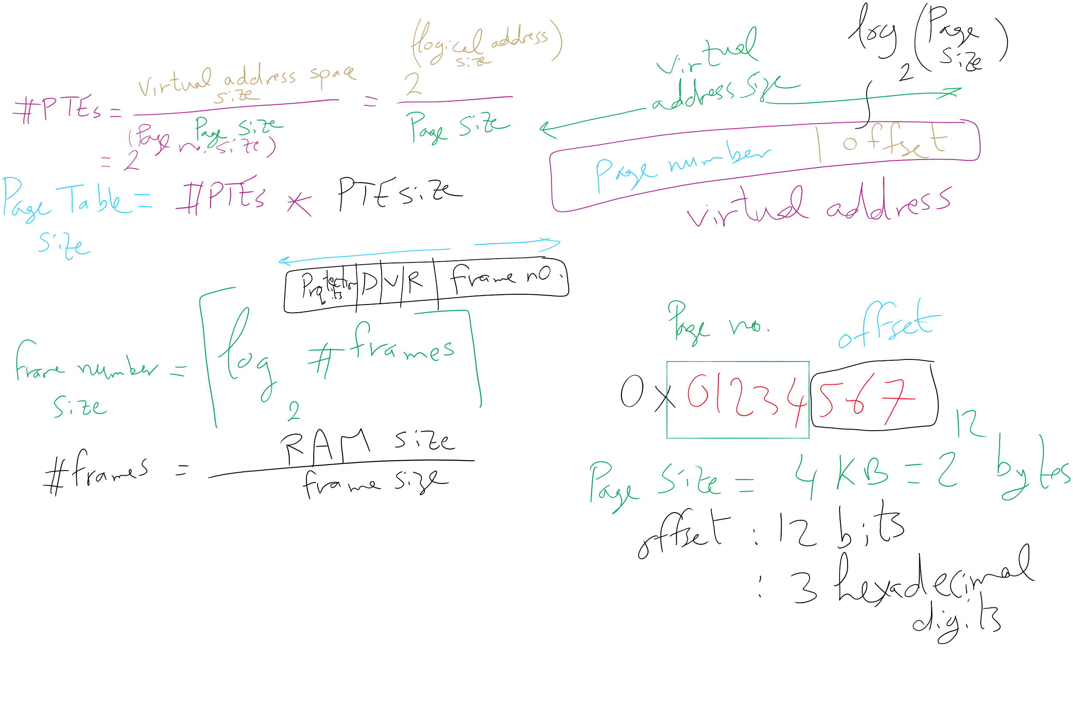
Virtual Address

Slide 7
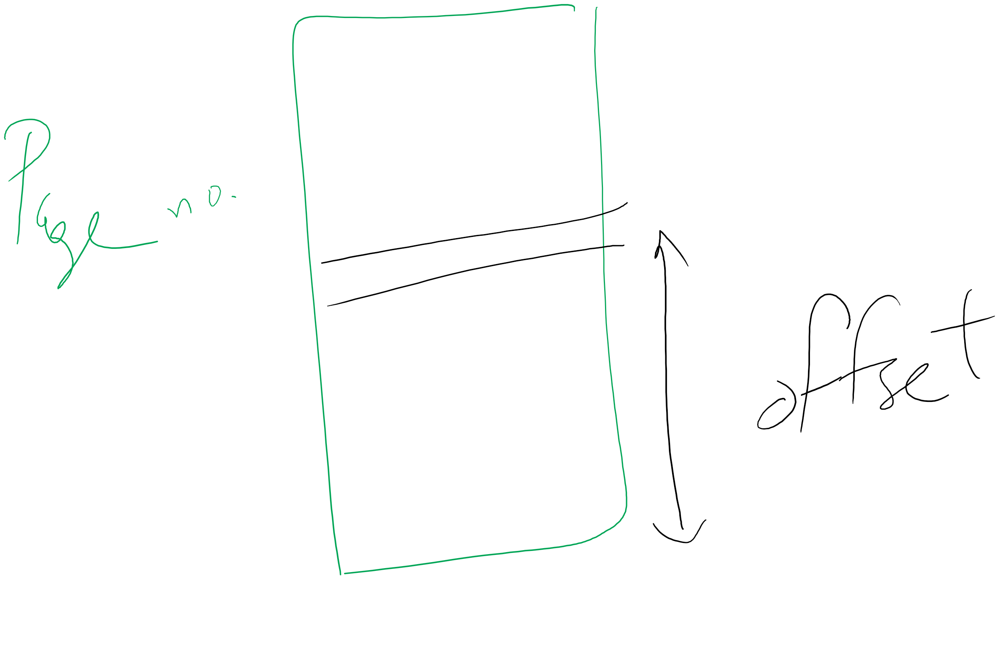
Page number vs. Offset

Slide 8
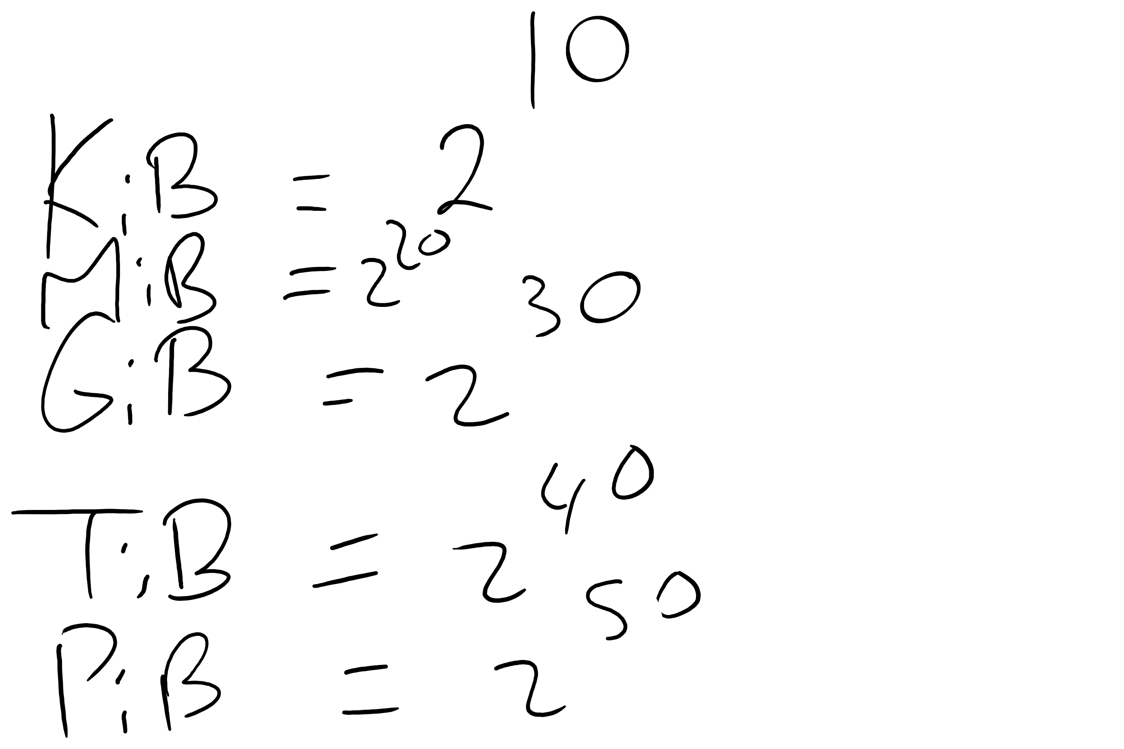
Memory Sizes

Slide 9
Example on splitting a virtual address

Slide 10
# PTEs

Slide 11
PTE Size

Slide 12
Page Table Size

Slide 13
Page Table Size
How big can a page table be?
64-bit machine → virtual address size = 64 bits
4 KB page size →page offset is log₂ 2¹² = 12 bits
How many pages?
How many PTEs?
#PTEs = 2⁶⁴ / page size = 2⁶⁴ / 2¹² = 2⁵²
How big is a PTE?
Assume 4 GB RAM (Physical Memory) = 2³² bytes
# Frames = 2³² / page size = 2³² / 2¹² = 2²⁰
Frame no. size = log₂ 2²⁰ = 20 bits
PTE size = 20 + (let’s say) 12 bits for flags = 32 bits = 4 bytes
How big is the page table of one process?
#PTEs * PTE size = 2⁵² * 4 = 2⁵⁴ bytes = 16 PB

Slide 14
Problem of the Day
How big is the page table of one process?
#PTEs * PTE size = 2⁵² * 4 = 2⁵⁴ bytes = 16 PB
Such page table is too big to put in memory!
But why does it have to be in memory?
Let’s see how address translation happens …

Slide 15
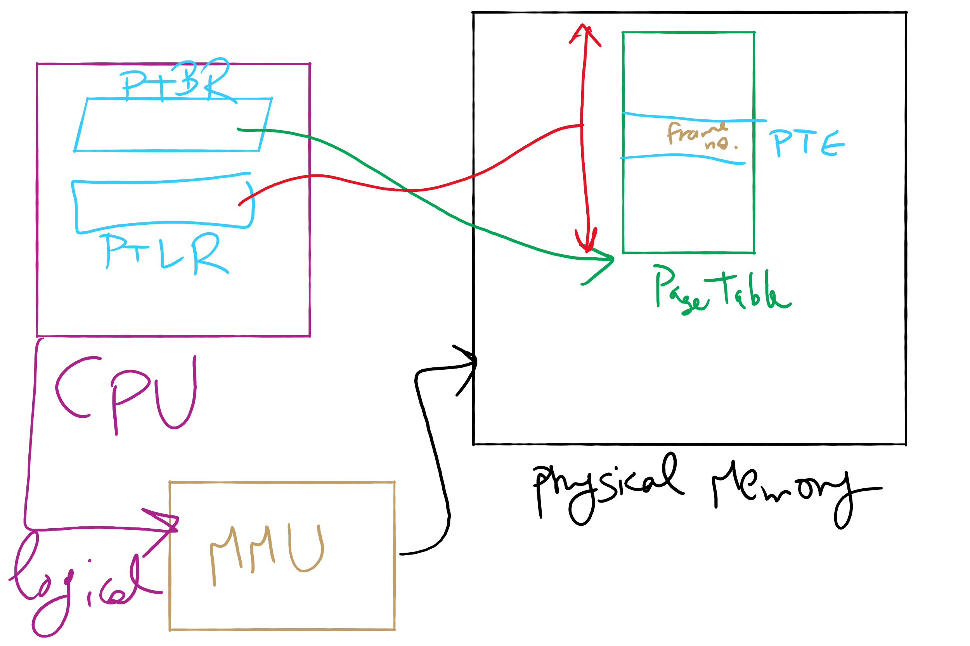
Address Translation Structures

Slide 16
Memory & paging structures
Physical memory
Page frame number
Page 0
6
Page 1
3
0
Page 1 (P1)
Page 2
4
1
Page 3
9
2
Page 4 (P0)
Page 4
2
3
Page 1 (P0)
Free
pages
4
Page 2 (P0)
Logical memory (P0)
Page table (P0)
5
6
Page 0 (P0)
Page 0
8
7
Page 1
0
8
Page 0 (P1)
9
Page 3 (P0)
Logical memory (P1)
Page table (P1)

Slide 17
Mapping logical => physical address
Split address from CPU into two pieces
Page number (p)
Page offset (d)
Page number
Index into page table
Page table contains base address of page in physical memory
Page offset
Added to base address to get actual physical memory address
Page size = 2^{d} bytes
Example:
• 4 KB (=4096 byte) pages
• 32 bit logical addresses
2^{d} = 4096
d = 12
32-12 = 20 bits
12 bits
p
d
32 bit logical address

Slide 18
Address translation architecture
page number
Page frame number
Page frame number
page offset
0
CPU
p
d
f
d
1
. . .
0
f-1
1
f
. . .
f+1
p-1
f+2
p
f
. . .
p+1
physical memory
page table

Slide 19
Solution 1: Two-level page tables
1st level page table called page directory
PDEs have pointers to 2nd level page tables
PTEs in 2nd level page table have actual physical page numbers
All addresses are physical
Protection bits kept in 2nd level
. . .
220
. . .
657
. . .
. . .
401
. . .
. . .
. . .
125
613
. . .
. . .
. . .
1st level page table
961
. . .
884
960
. . .
2nd level page tables
. . .
main memory
955

Slide 20
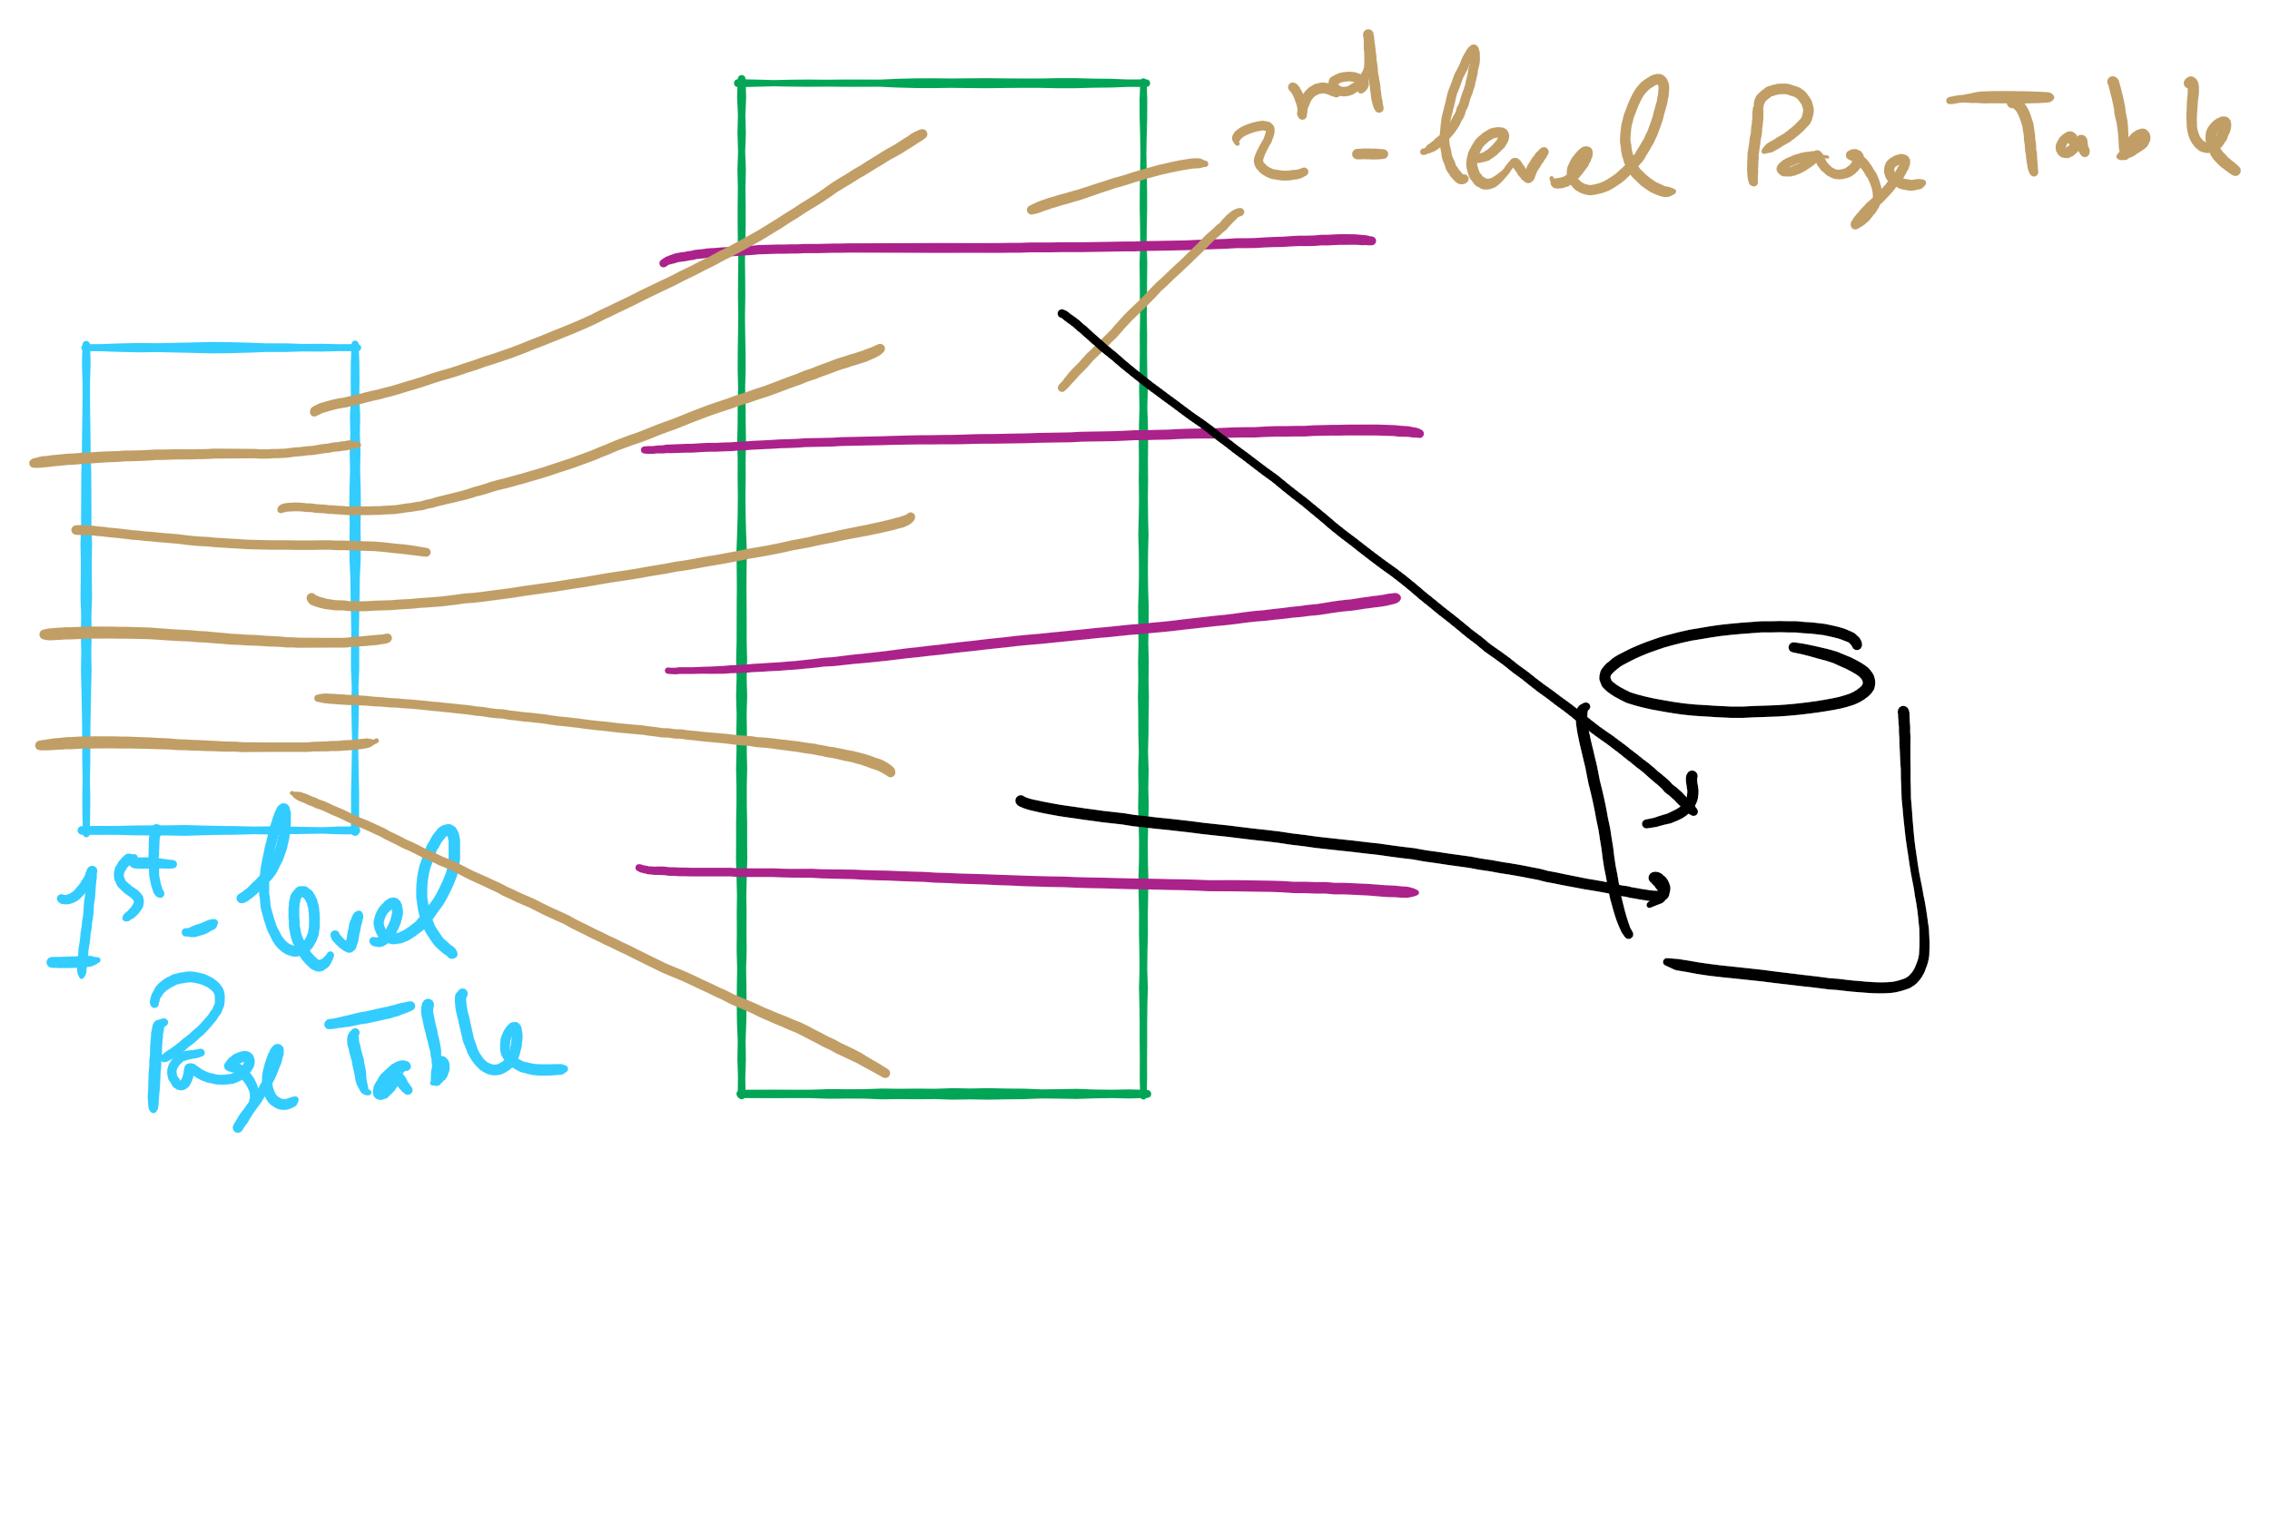
How does that solve the problem?
2nd level page tables don’t have to be in memory all at once
can be loaded on demand
PDEs marked invalid in first page table

Slide 21
More on two-level page tables
Total number of bits indexing 1st and 2nd level table is constant for a given page size and logical address length. Why?
More bits in 1st level: fine granularity at 2nd level
Fewer bits in 1st level: maybe less wasted space?

Slide 22
Two-level paging: address translation
8 KB pages
32-bit logical address
p₁ is an index into the 1st level page table
p₂ is an index into the 2nd level page table pointed to by p₁
page number
page offset
p₁ = 10 bits
p₂ = 9 bits
offset = 13 bits

Slide 23
2-level address translation example
page number
page offset
p₁ = 10 bits
p₂ = 9 bits
offset = 13 bits
0
Page table base
physical address
frame number
1
0
19
13
. . .
1
. . .
0
1
p₁
. . .
. . .
. . .
p₂
main memory
1st level page table
. . .
2nd level page table

Slide 24
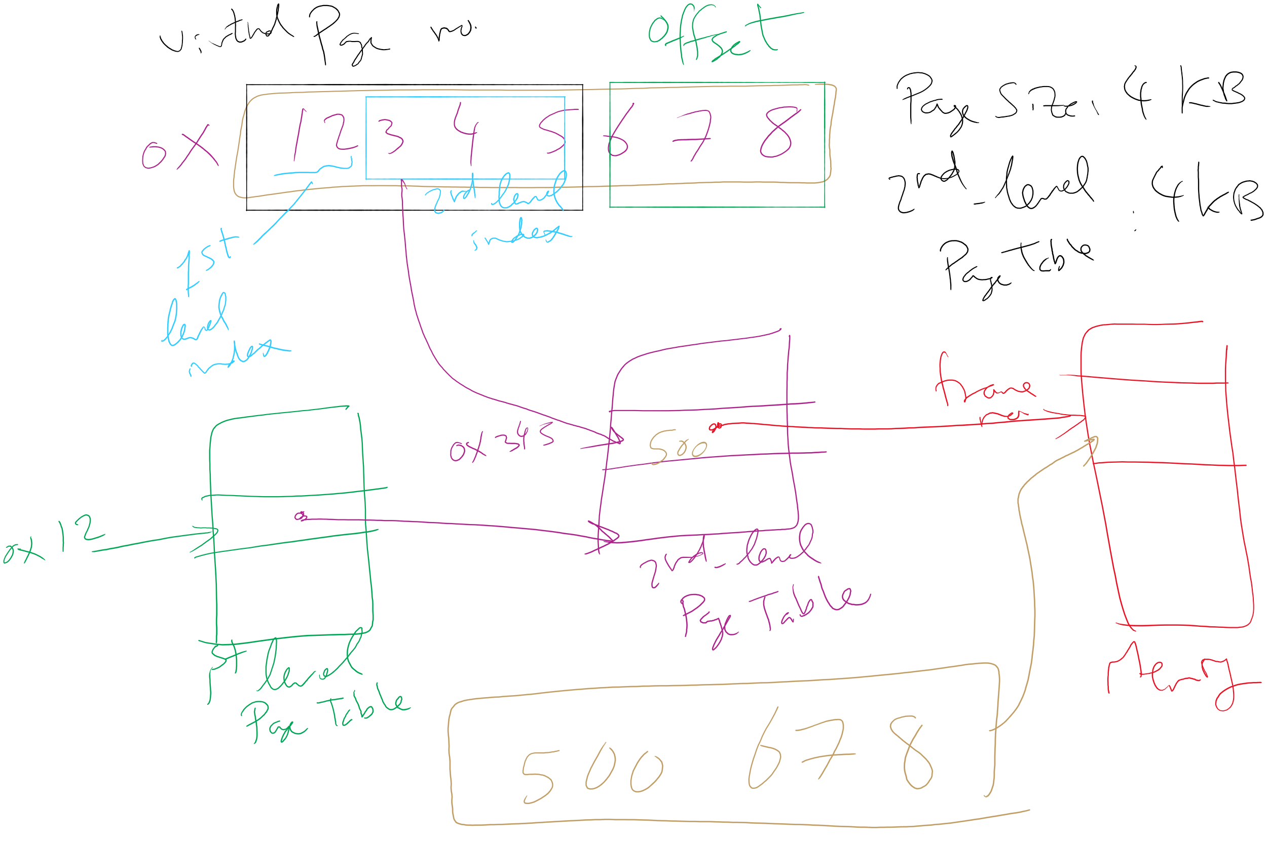
Address Translation: 2-level Page Table

Slide 25
Translation Lookaside Buffer (TLB)
Search the TLB for the desired logical page number
Search entries in parallel
Use standard cache techniques
If desired logical page number is found, get frame number from TLB
If desired logical page number isn’t found
Get frame number from page table in memory
Replace an entry in the TLB with the logical & physical page numbers from this reference
Logical page #
Physical frame #
8
3
unused
2
1
3
0
12
12
29
6
22
11
7
4
Example TLB

Slide 26
Handling TLB misses
If PTE isn’t found in TLB, OS needs to do the lookup in the page table
Lookup can be done in hardware or software
Hardware TLB replacement
CPU hardware does page table lookup
Can be faster than software
Less flexible than software, and more complex hardware
Software TLB replacement
OS gets TLB exception
Exception handler does page table lookup & places the result into the TLB
Program continues after return from exception
Larger TLB (lower miss rate) can make this feasible

Slide 27
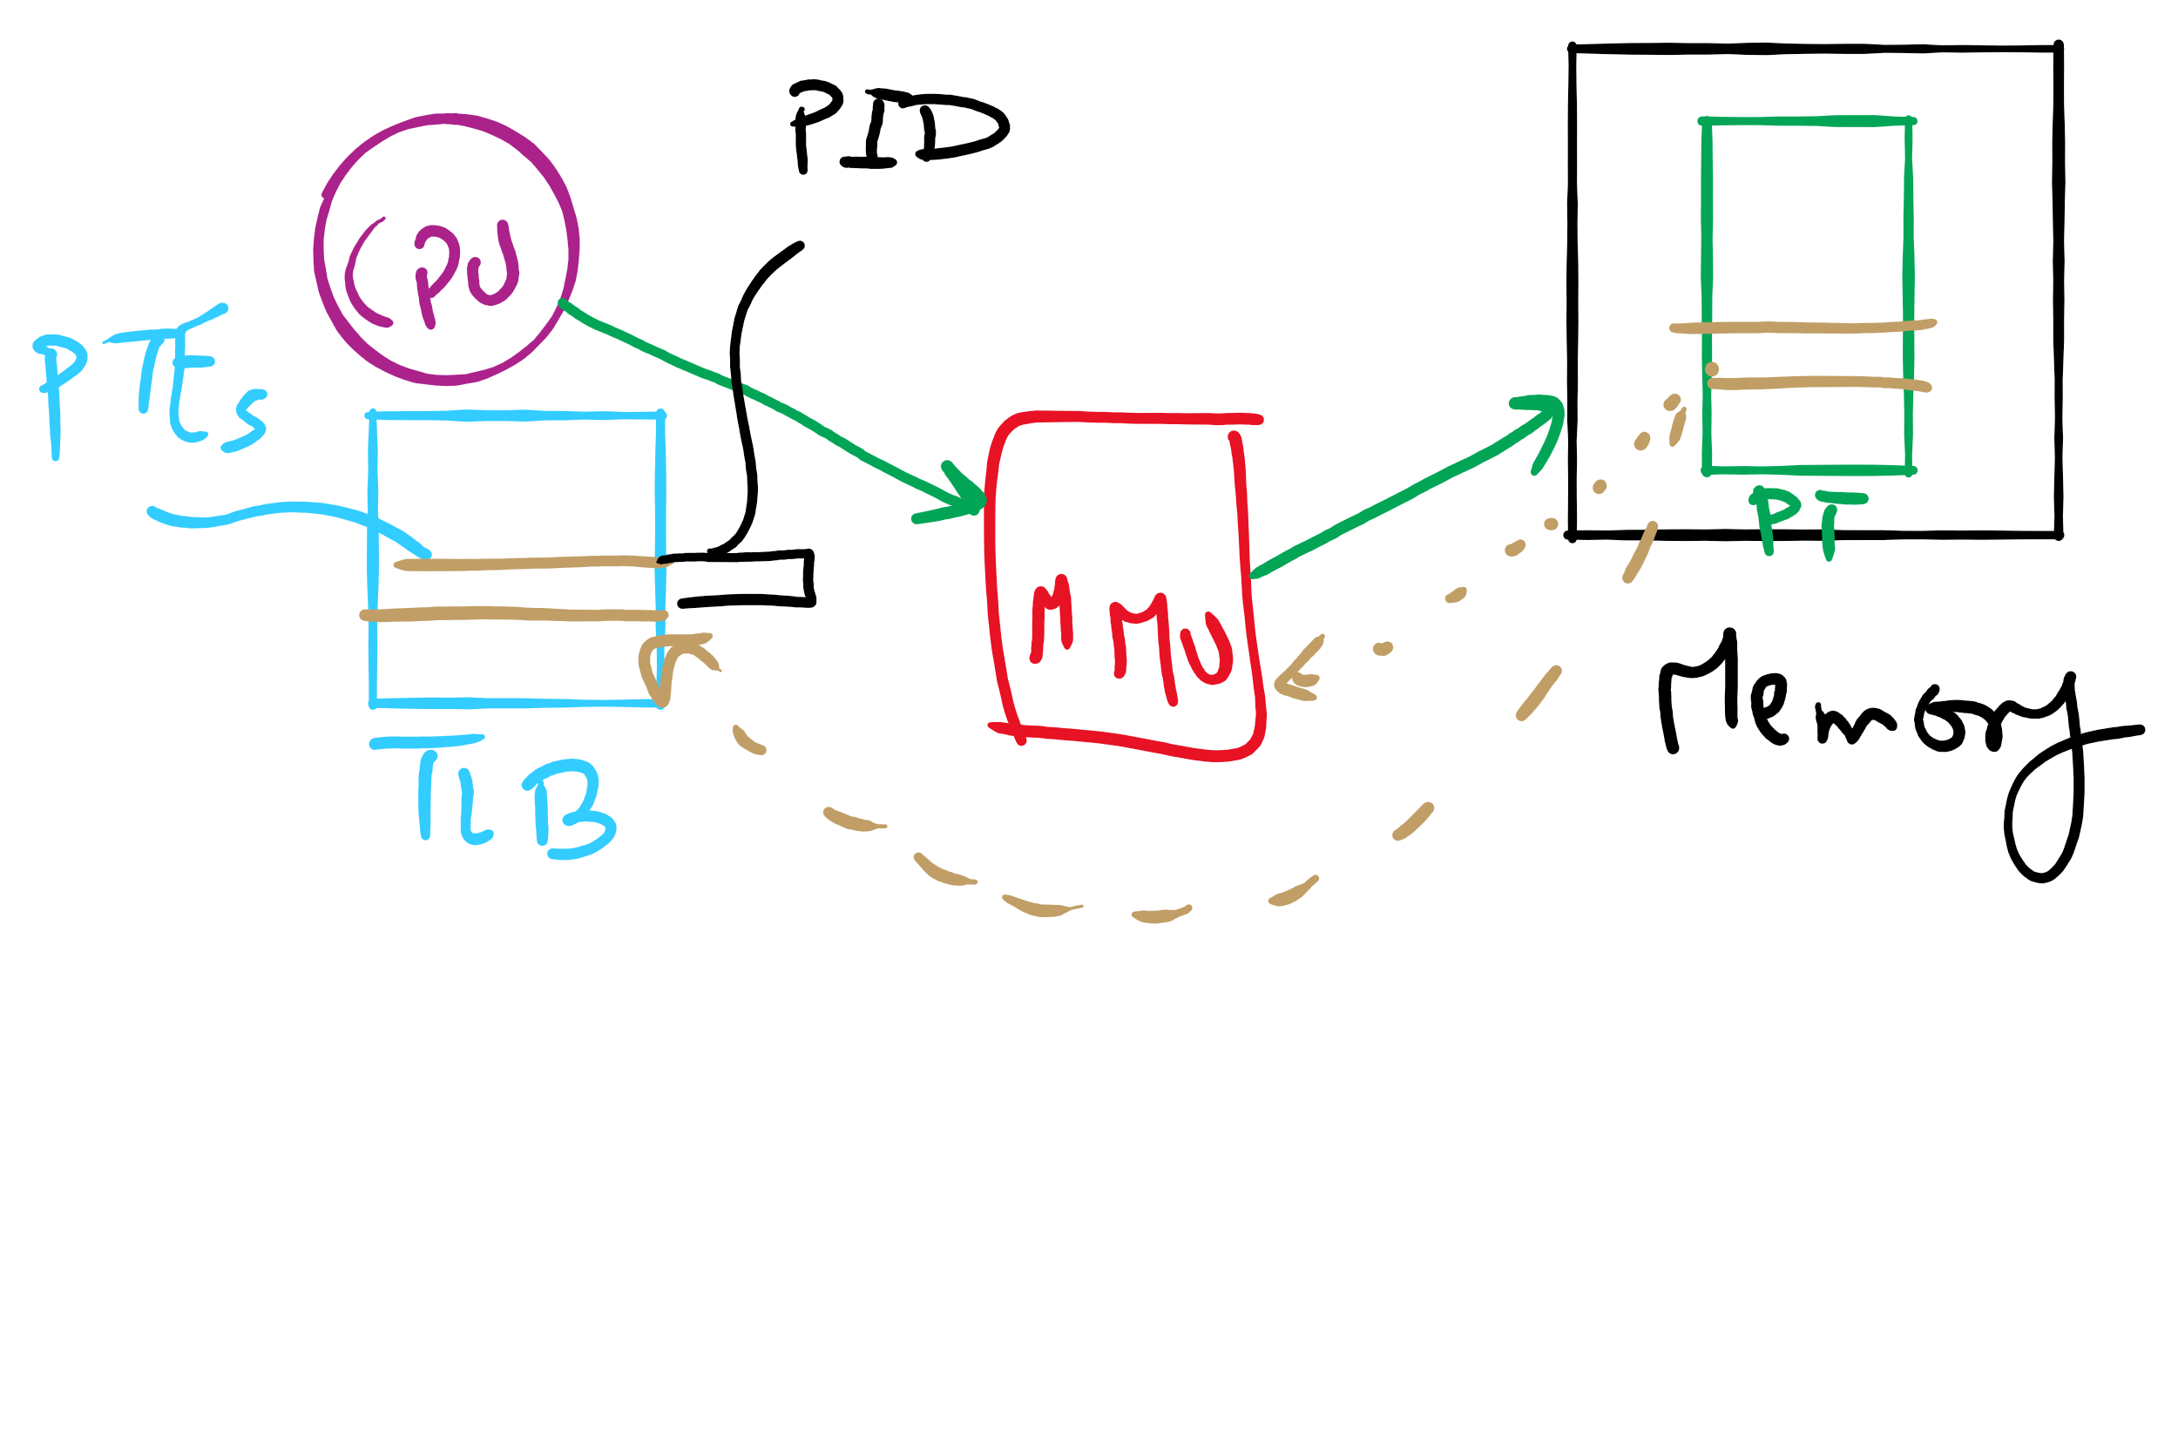
TLB

Slide 28
How long do memory accesses take?
Assume the following times:
TLB lookup time = a (often zero - overlapped in CPU)
Memory access time = m
Hit ratio (h) is percentage of time that a logical page number is found in the TLB
Larger TLB usually means higher h
TLB structure can affect h as well
Effective access time (an average) is calculated as:
EAT = (m + a)h + (m + m + a)(1-h)
EAT =a + (2-h)m
Interpretation
Reference always requires TLB lookup, 1 memory access
TLB misses also require an additional memory reference

Slide 29
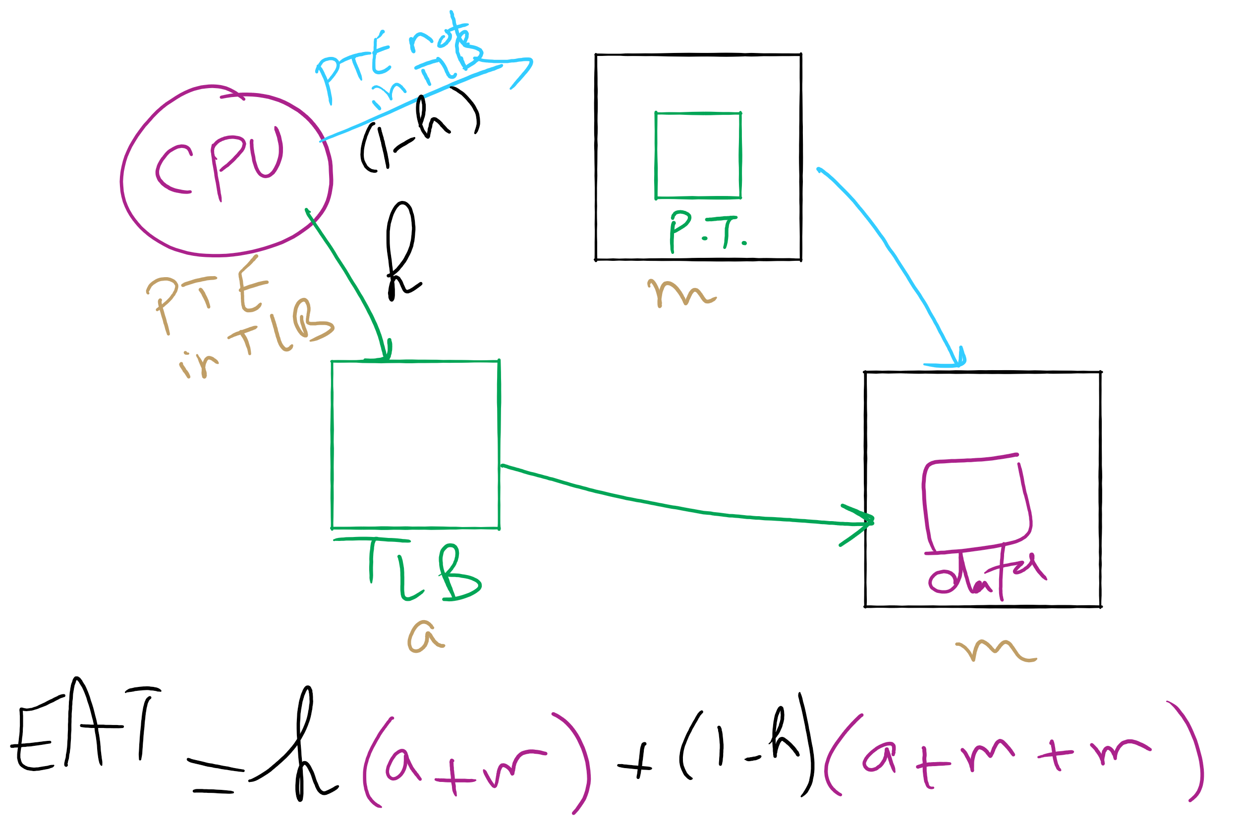
Effective Access Time

Slide 30
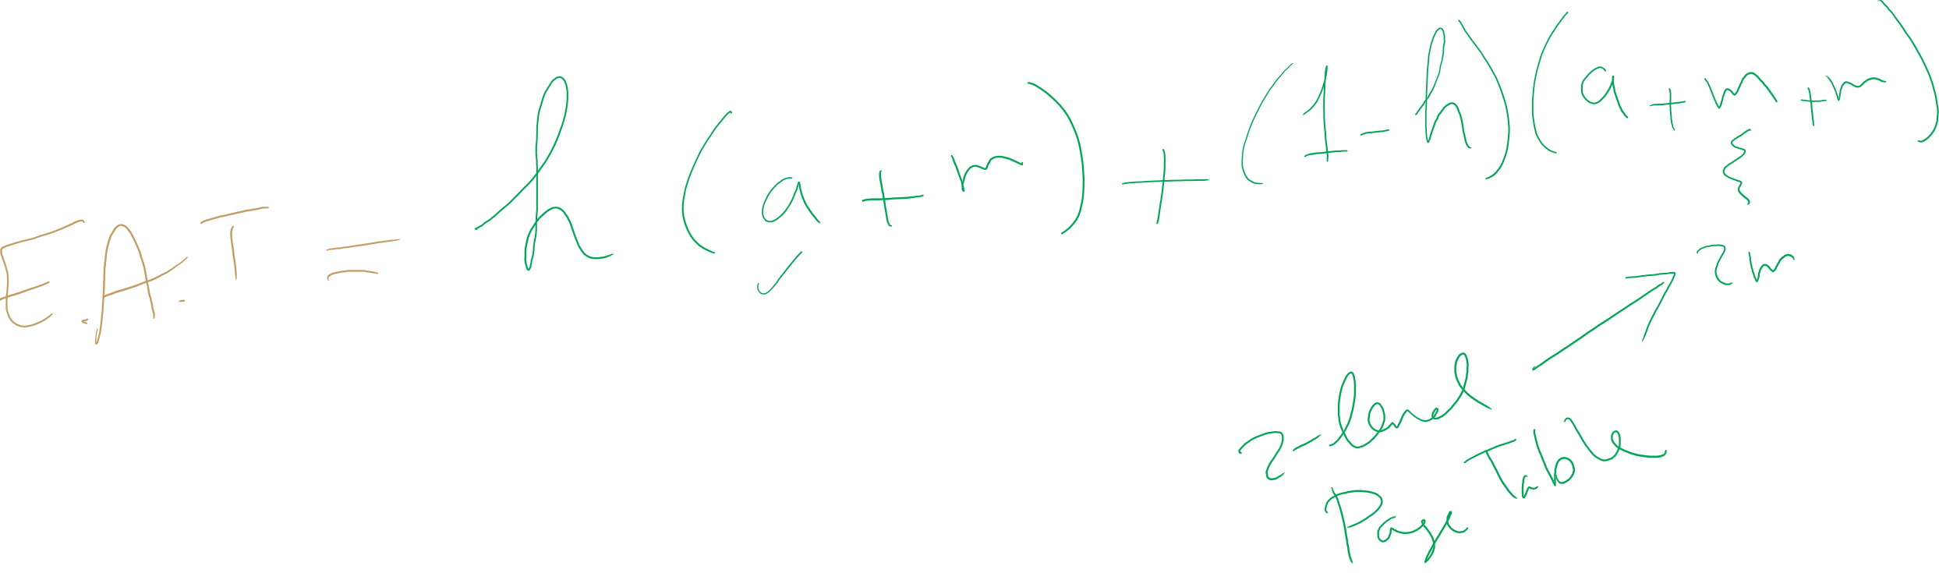
EAT Calculation

Slide 31
Solution 2: Inverted page table
One entry for each frame in memory
One table for the entire system
PTE contains
Virtual address pointing to this frame
Information about the process that owns this page
Search page table by
Hashing the virtual page number and process ID
Starting at the entry corresponding to the hash result
Search until either the entry is found or a limit is reached
Page frame number is index of PTE in the table
Improve performance by using more advanced hashing algorithms

Slide 32
Inverted page table architecture
page number
page offset
process ID
p = 19 bits
offset = 13 bits
0
pid
p
1
19
13
. . .
search
0
pid₀
p₀
Page frame number
1
pid₁
p₁
. . .
. . .
k
k
pid_{k}
p_{k}
main memory
. . .
inverted page table

Slide 33
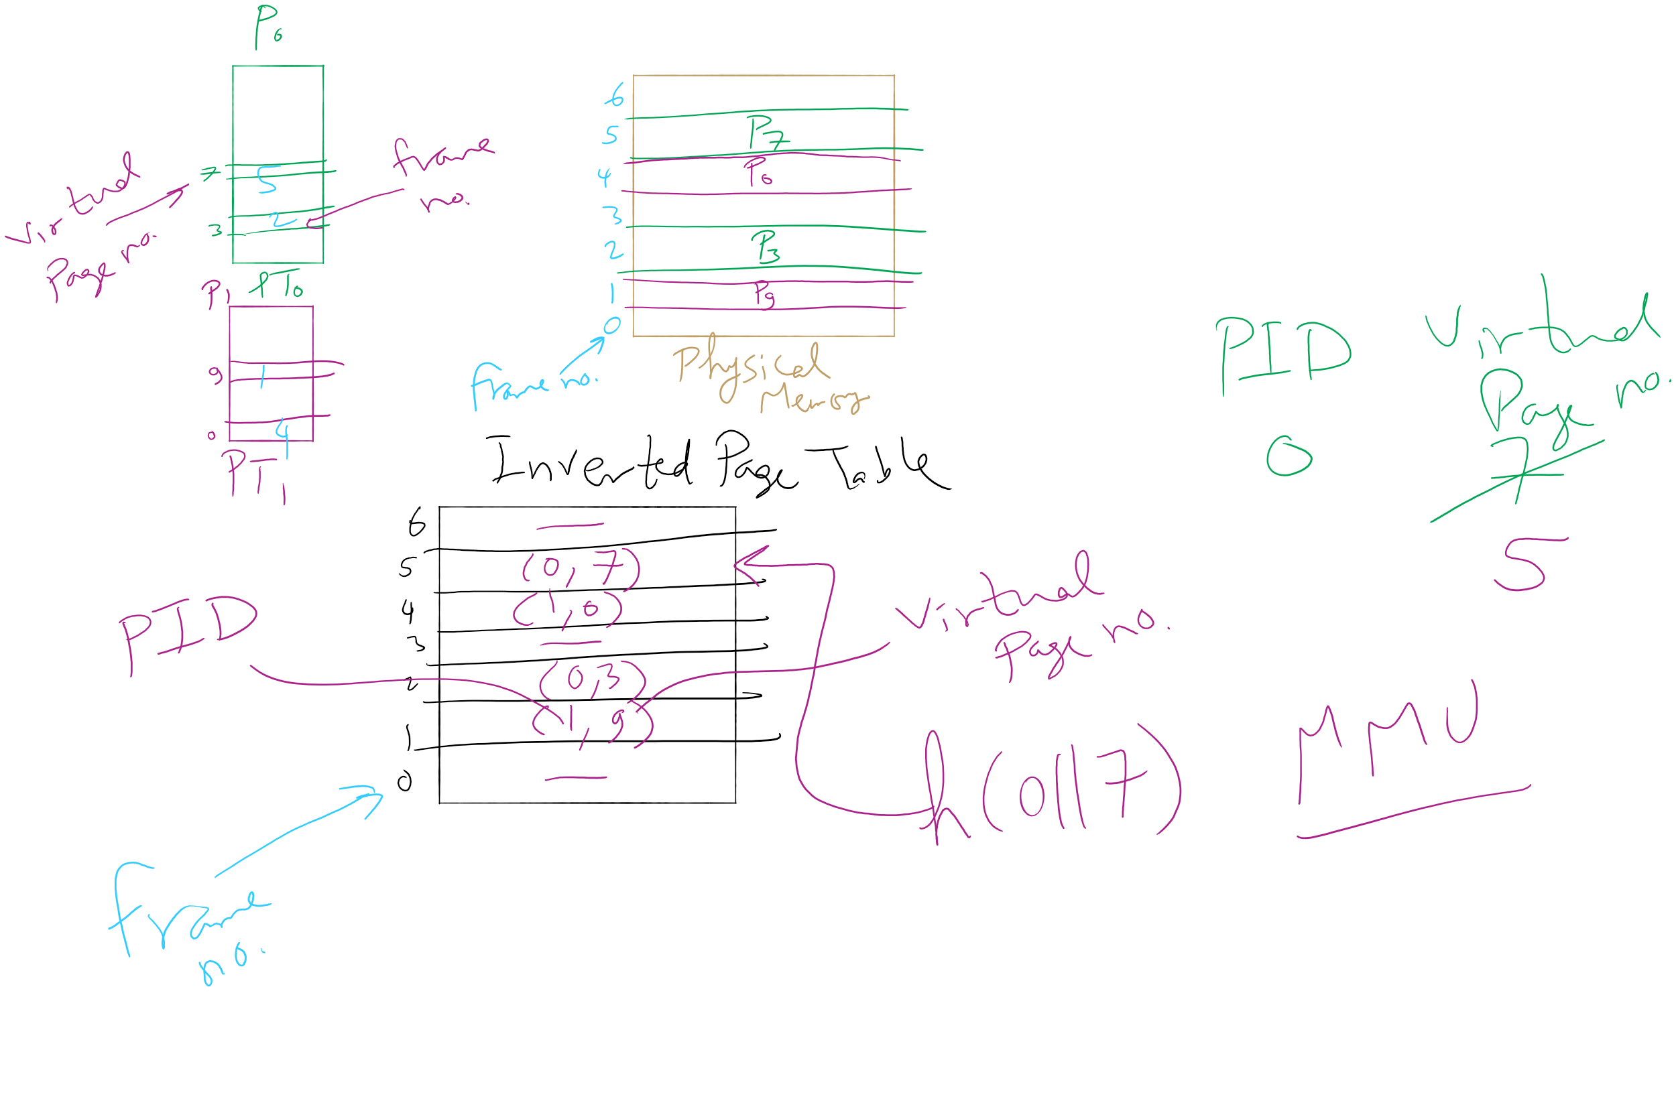
Inverted Page Table Example

Slide 34
Inverted Page Table Example

Slide 35
Inverted Page Table Example

Slide 36
How big should a page be?
Smaller pages have advantages
Less internal fragmentation
Better fit for various data structures, code sections
Less unused physical memory (some pages have 20 useful bytes and the rest isn’t needed currently)
Larger pages are better because
Less overhead to keep track of them
Smaller page tables
TLB can point to more memory (same number of pages, but more memory per page)
Faster paging algorithms (fewer table entries to look through)
More efficient to transfer larger pages to and from disk

Slide 37
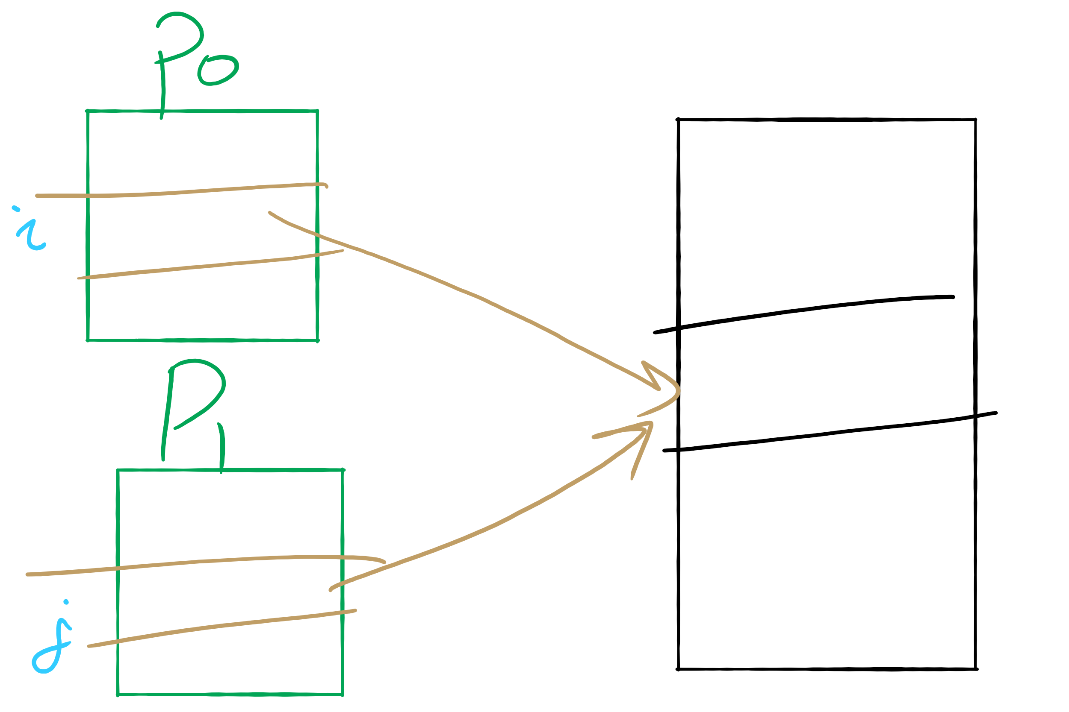
Sharing Pages

Slide 38
Sharing pages
Processes can share pages
Entries in page tables point to the same physical page frame
Easier to do with code: no problems with modification
Virtual addresses in different processes can be…
The same: easier to exchange pointers, keep data structures consistent
Different: may be easier to actually implement
Not a problem if there are only a few shared regions
Can be very difficult if many processes share regions with each other

Slide 39
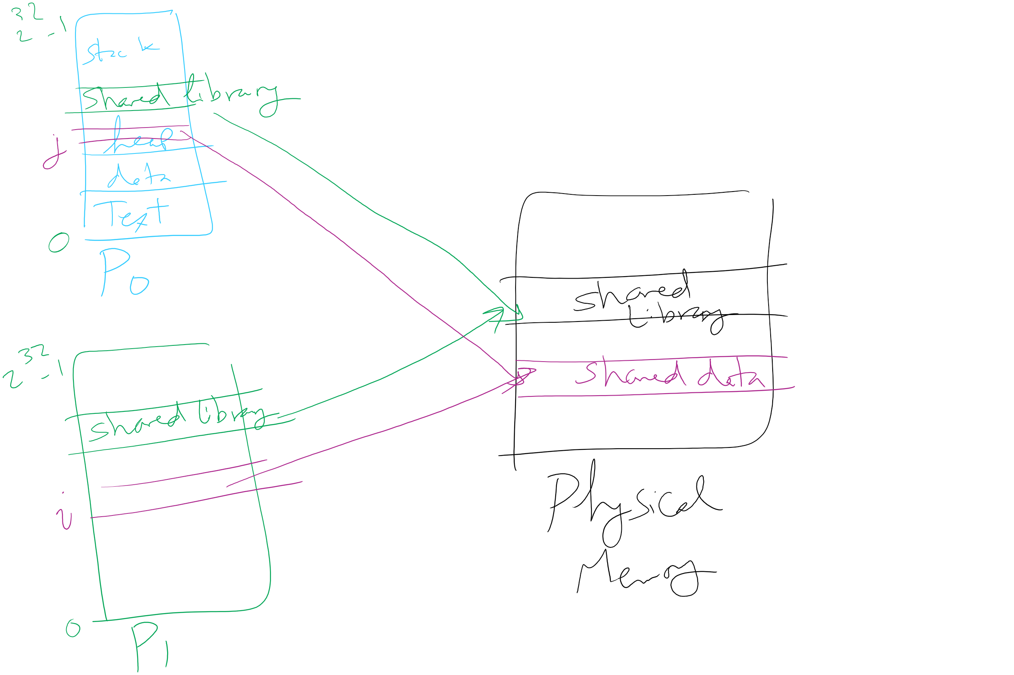
Page Sharing

Slide 40
Implementation issues
Four times when OS involved with paging
Process creation
Determine program size
Create page table
During process execution
Reset the MMU for new process
Flush the TLB (or reload it from saved state)
Page fault time
Determine virtual address causing fault
Swap target page out, needed page in
Process termination time
Release page table
Return pages to the free pool

Slide 41
How is a page fault handled?
Hardware causes a page fault
General registers saved (as on every exception)
OS determines which virtual page needed
Actual fault address in a special register
Address of faulting instruction in register
Page fault was in fetching instruction, or
Page fault was in fetching operands for instruction
OS must figure out which…
OS checks validity of address
Process killed if address was illegal
OS finds a place to put new page frame
If frame selected for replacement is dirty, write it out to disk
OS requests the new page from disk
Page tables updated
Faulting instruction backed up so it can be restarted
Faulting process scheduled
Registers restored
Program continues

Slide 42
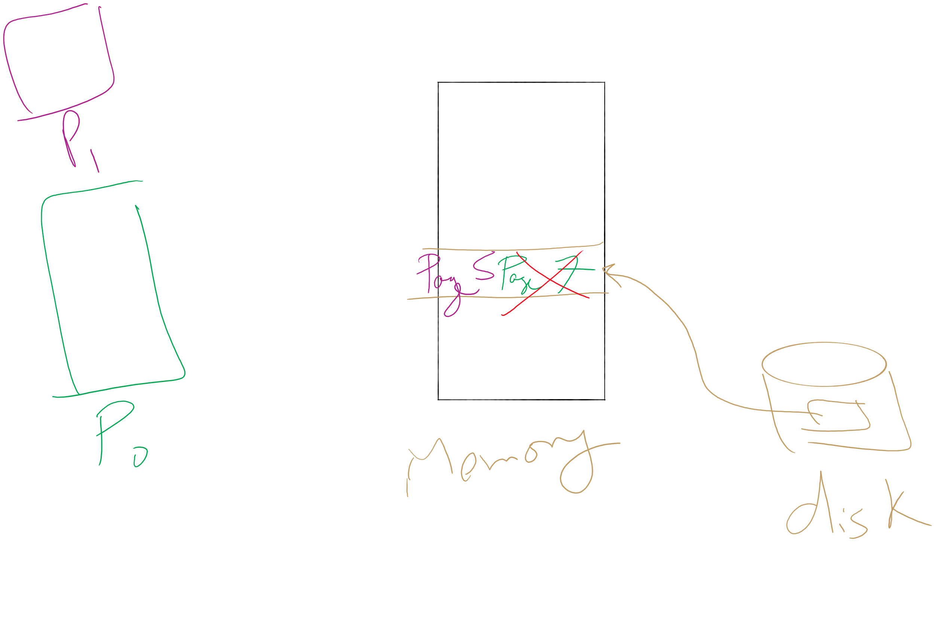
Page locking

Slide 43
Locking pages in memory
Virtual memory and I/O occasionally interact
P1 issues call for read from device into buffer
While it’s waiting for I/O, P2 runs
P2 has a page fault
P1’s I/O buffer might be chosen to be paged out
This can create a problem because an I/O device is going to write to the buffer on P1’s behalf
Solution: allow some pages to be locked into memory
Locked pages are immune from being replaced
Pages only stay locked for (relatively) short periods

Slide 44
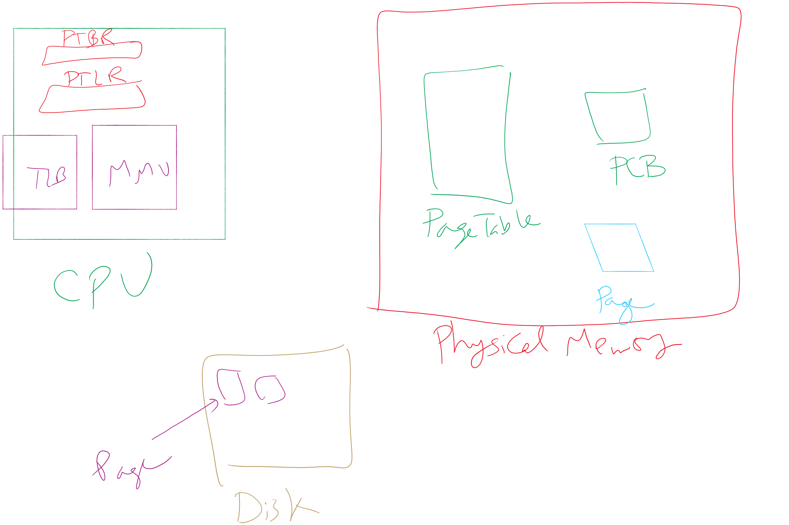
Map of MMU, TLB, Page Table, etc.

Slide 45
When are dirty pages written to disk?
On demand (when they’re replaced)
Fewest writes to disk
Slower: replacement takes twice as long (must wait for disk write and disk read)
Periodically (in the background)
Background process scans through page tables, writes out dirty pages that are pretty old
Background process also keeps a list of pages ready for replacement
Page faults handled faster: no need to find space on demand
Cleaner may use the same structures discussed earlier (clock, etc.)

Slide 46
Control overall page fault rate
Despite good designs, system may still thrash
Most (or all) processes have high page fault rate
Some processes need more memory, …
but no processes need less memory (and could give some up)
Problem: no way to reduce page fault rate
Solution : Reduce number of processes competing for memory
Swap one or more to disk, divide up pages they held
Reconsider degree of multiprogramming

Slide 47

Backing up an instruction
Problem: page fault happens in the middle of instruction execution
Some changes may have already happened
Others may be waiting for VM to be fixed
Solution: undo all of the changes made by the instruction
Restart instruction from the beginning
This is easier on some architectures than others
Example: LW R1, 12(R2)
Page fault in fetching instruction: nothing to undo
Page fault in getting value at 12(R2): restart instruction

Slide 48
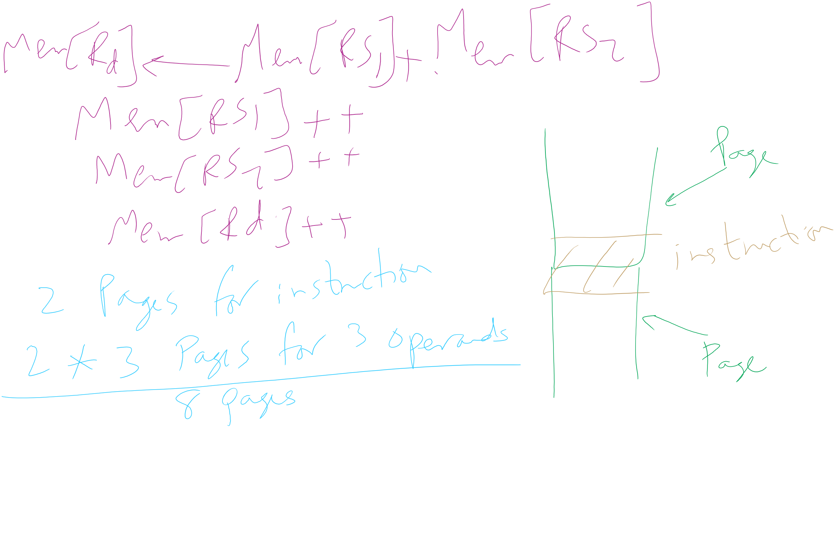
Minimum memory allocation to a process
Example: ADD (Rd)+,(Rs1)+,(Rs2)+
Page fault in writing to (Rd): may have to undo an awful lot…

Slide 49
Separating policy and mechanism
Mechanism for page replacement has to be in kernel
Modifying page tables
Reading and writing page table entries
Policy for deciding which pages to replace could be in user space
More flexibility
3. Request page
User process
External pager
4. Page arrives
User space
2. Page needed
5. Here is page!
Kernel space
Fault handler
MMU handler
1. Page fault
6. Map in page

Slide 50
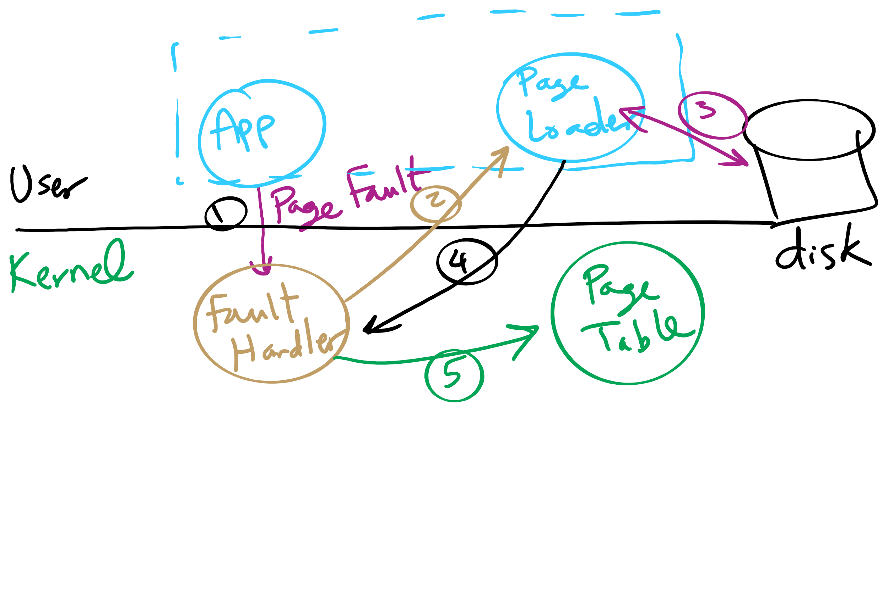
Separating Policy and Mechanism for Page Replacement

